Slide 1
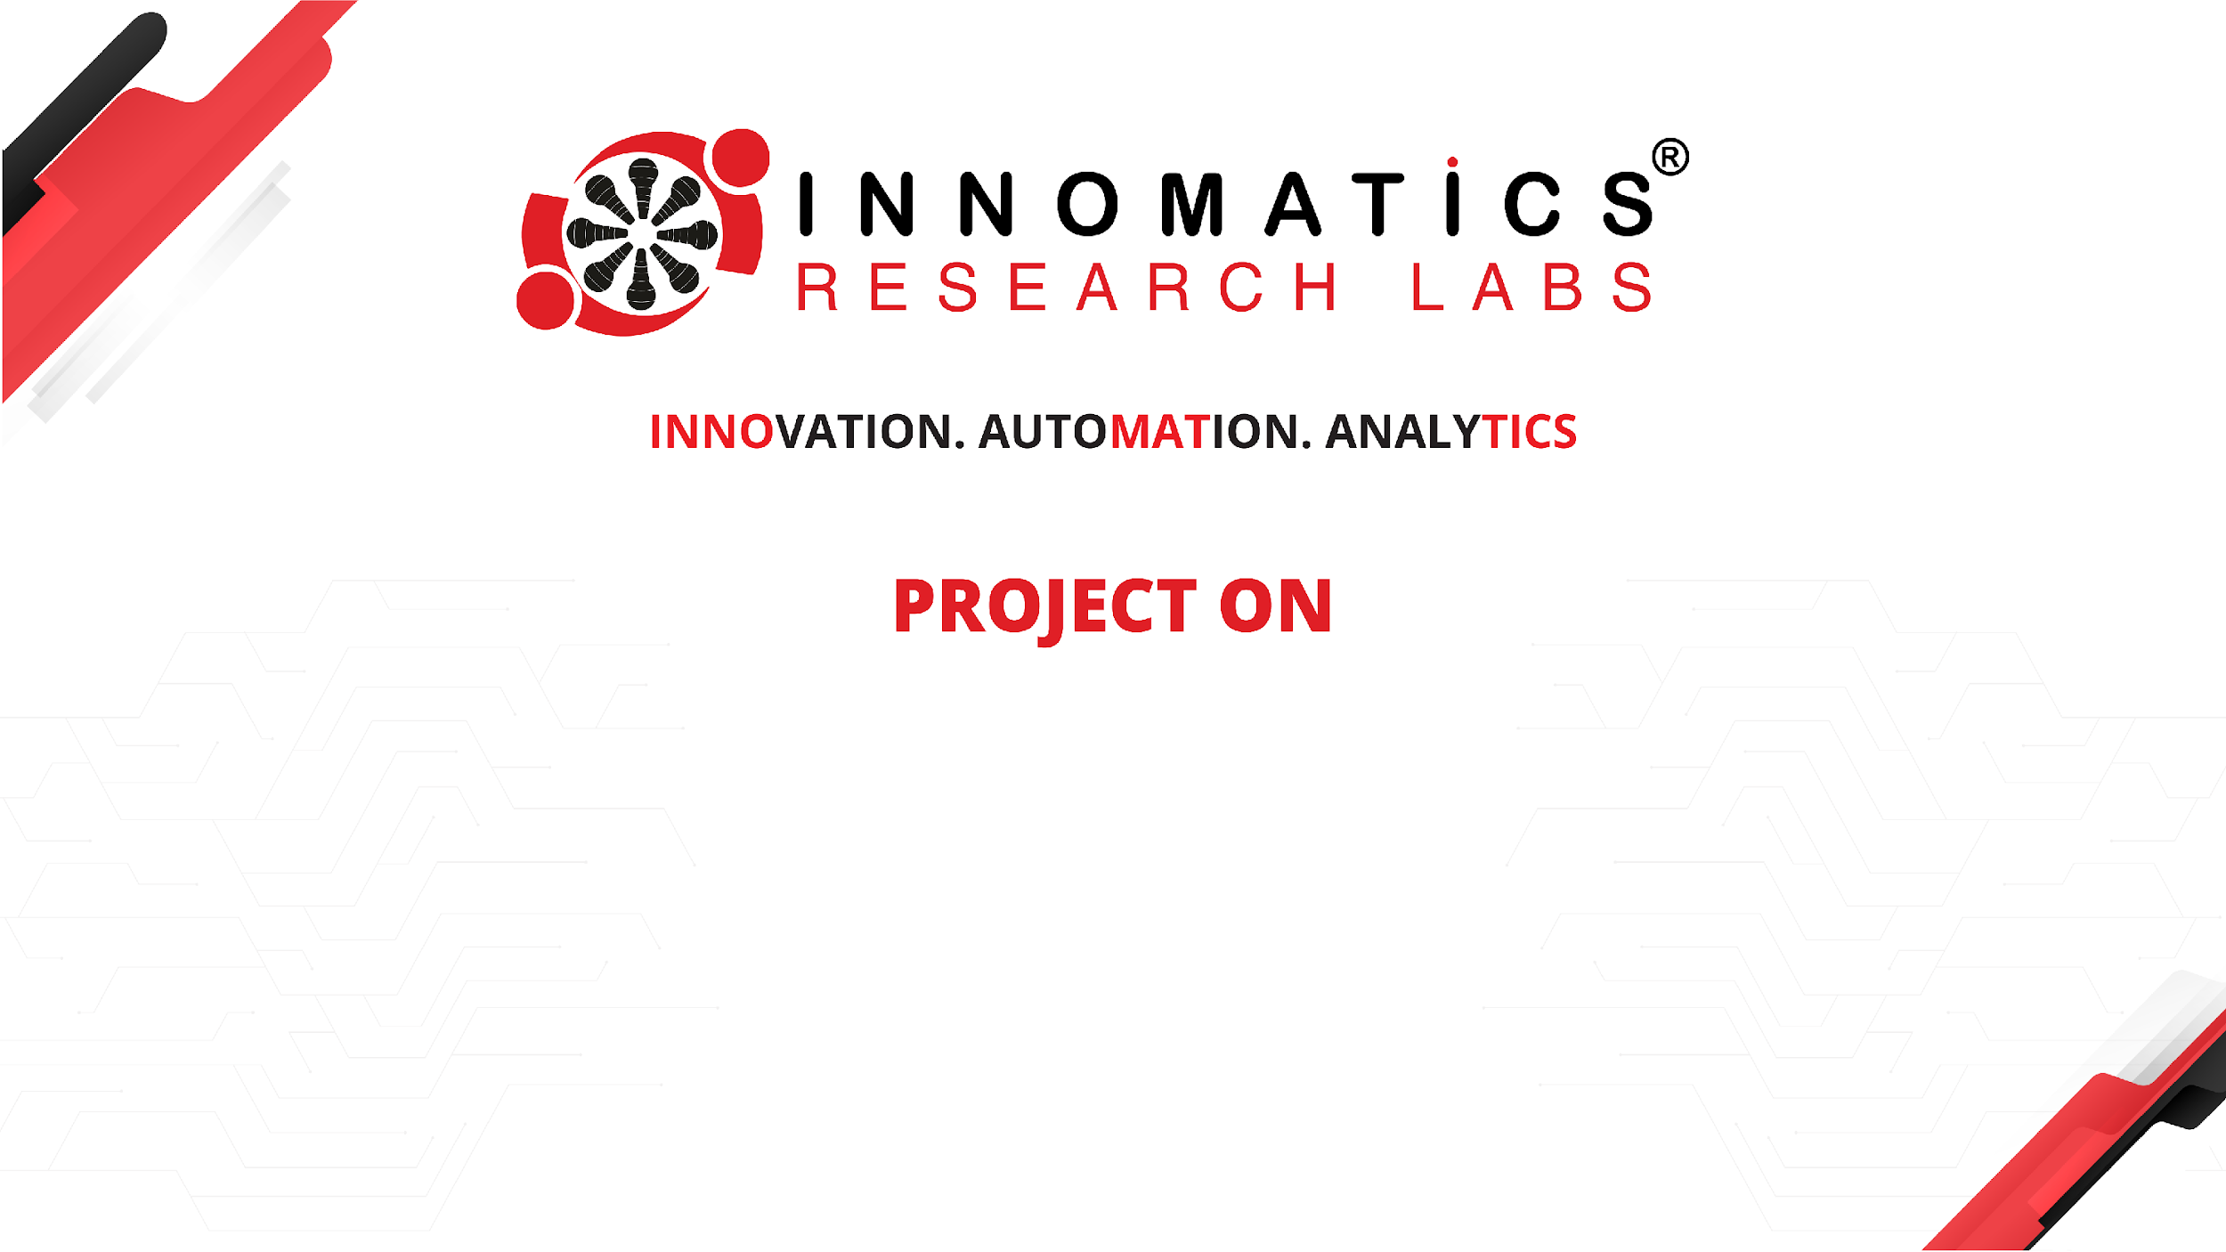
Code Refactoring and Bug Report Analysis
Presented by - Dinesh Nakkina

Slide 2
About me
As a dedicated professional with a Master's degree in Statistics, I am deeply passionate about leveraging data to solve complex problems and drive informed decision-making. With a keen eye for detail and a love for uncovering insights within vast datasets, I thrive on the challenge of turning raw data into actionable solutions.
My expertise in statistics equips me with the necessary tools to analyze, model, and interpret data effectively. Whether it's identifying trends, predicting outcomes, or optimizing processes, I am committed to delivering accurate and meaningful results that drive business success.
Furthermore, my collaborative nature and ability to communicate effectively allow me to work seamlessly within diverse teams, leveraging collective insights to achieve common goals. I believe in the power of collaboration and the value it brings to problem-solving and innovation.
Beyond data analysis, I am also proficient in Flask app development, enabling me to create user-friendly interfaces for showcasing insights and deploying data-driven solutions. This additional skill enhances my ability to translate complex data into actionable outcomes, further amplifying the impact of my work.
In summary, my passion for data, coupled with my expertise in statistics and Flask development, positions me as a valuable asset in the field of Data Science. I am excited about the opportunity to continue exploring and contributing to this dynamic and rapidly evolving field.

Slide 3
Problem Statement
Refactor the existing codebase and ensure the proper functioning of the Note Taking Application. Document all identified bugs during the debugging process. Remember, the task is not about recreating the app from scratch. Your goal is to fix the already existing codebase and make the application work as intended.
Technologies Used
Python
Flask
Html
CSS

Slide 4
Application Description
This project is a straightforward yet powerful Note Taking Application built using Flask. With this app, users can easily manage their notes, including adding new ones, deleting specific notes, or even clearing out their entire note collection.
Key features of the application include:
Note Creation: Users can effortlessly add new notes to their collection. Whether it's jotting down thoughts, reminders, or important information, the app provides a seamless interface for creating and organizing notes.
Note Deletion: The app offers the flexibility to delete individual notes as needed. Whether a note is no longer relevant or requires updating, users can easily remove it from their list with just a few clicks.
Bulk Note Deletion: In addition to deleting individual notes, the application allows users to clear out their entire note collection in one go. This feature provides convenience and efficiency for users who wish to start fresh or declutter their notes.

Slide 5
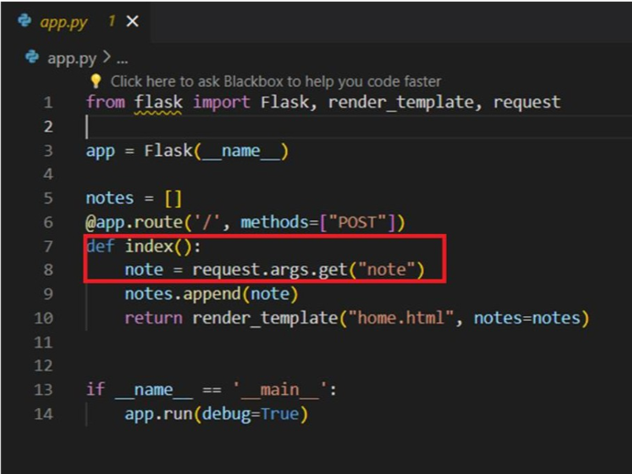
Bug Description
Initially, the Flask application is configured to handle only POST requests in the route, and it attempts to retrieve the note from the request arguments using request.args.get(‘note’) which results in Method not allowed error
Here is the Initial Codebase:

Slide 6
Approach and Changes made
The approach is to handle both get and post requests and updating the logic to retrieve the note from the form data.
Changed the route decorator to handle both get and post requests
Updated the logic to retrieve the note from the form data for post requests using request.form.get(‘note’)
Modified the code for individually deleting the note and also deleting the entire note

Slide 7
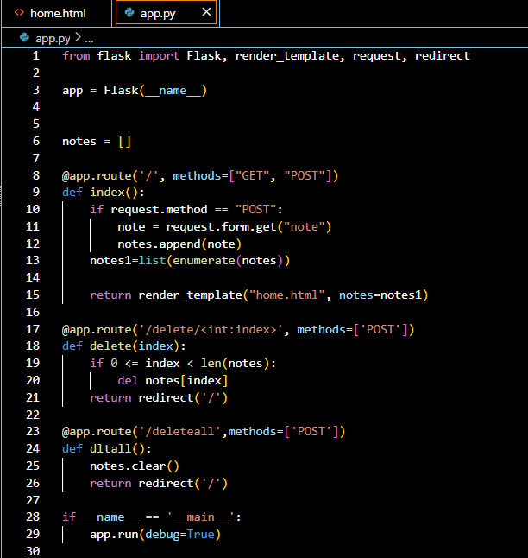
Modified Code

Slide 8
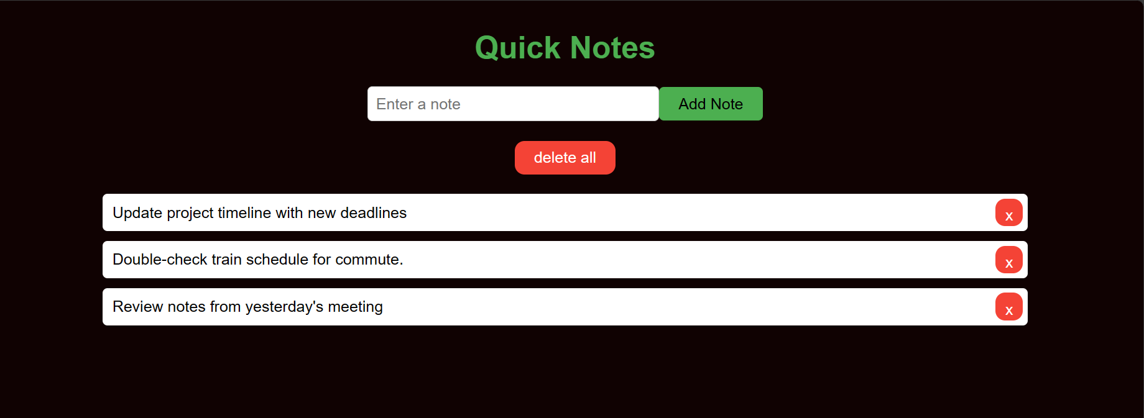
Final Output

Slide 9

THANK YOU

